Slide 1

My self
: egqa1
(Ha ha ha )

Slide 2
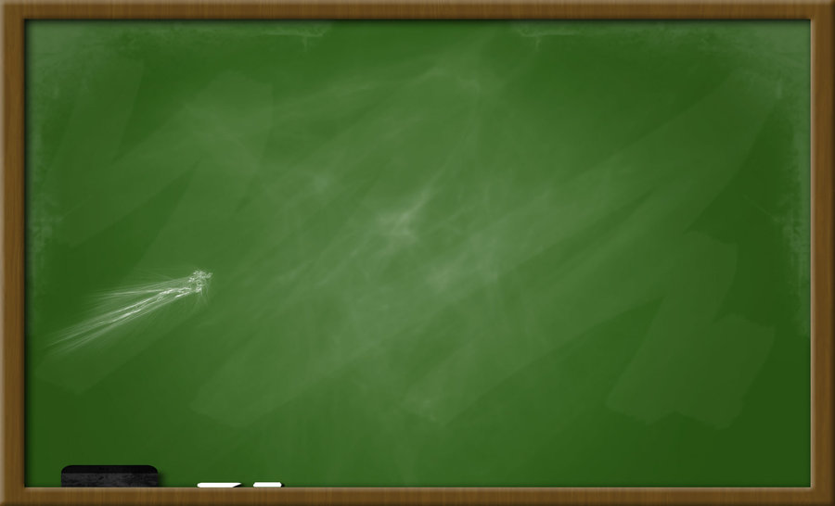


Information:
Name:
Ahmed Ayman
Birthday:
13\7\2001
Country:
Egypt

Slide 3
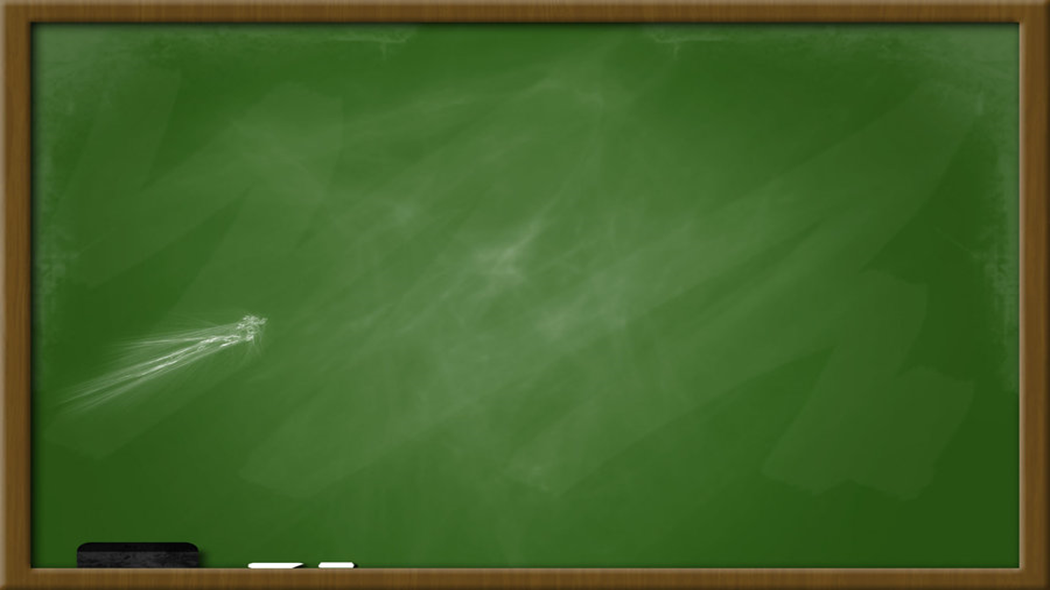


I was:
* A boxing player.
* A Thai boxing player.
*Living in Qatar.

Slide 4
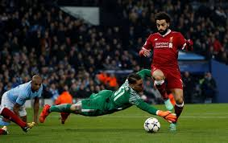
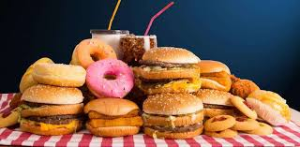


Hobbies:
- Football
- Boxing
- Swimming
- Eating
- Movies
- Video games
-Computers

